Slide 1
Session 16 : Hard and Soft Keyboards
Module 4.3 : Android

Slide 2
Learning Objectives
At the end of the session successful participants will be able to
Describe hard and soft keyboards.
Understand Input Method Framework (IMF)
Learn different Input types
Set Input types
XML approach
Programming Approach
Understand SoftKeyboard Window
Implement TextWatcher Demo

Slide 3
Hard And Soft Keyboards
Input Method Framework (IMF)
Android r1.5 introduced the notion of Input Method Framework (IMF).
The idea is to let the IFM arbitrate the interaction between applications and the current input method chosen by the user.

Slide 4
Hard And Soft Keyboards
Input Method Framework (IMF)
The motivation behind this framework is the realization that as Android matures, more hardware /software devices, and input techniques will appear in user’s applications, for instance:
Real & virtual keyboards
voice recognition
hand writing, etc.

Slide 5
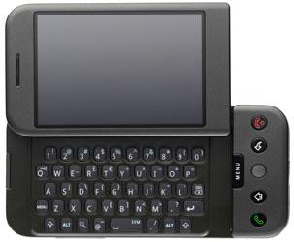
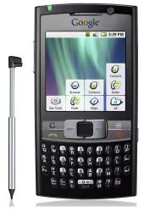
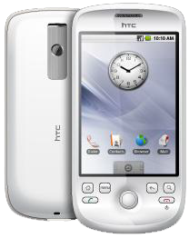
Hard And Soft Keyboards
Input Method Framework (IMF)
Keyboarding data into Android’s applications is functionally dependent of the hardware present in the actual device.
HTC –G1 Sliding Window exposes (occasionally) a hard keyboard
Samsung Model shows a permanent hard keyboard
HTC - Magic Model shown has no hard keyboard

Slide 6
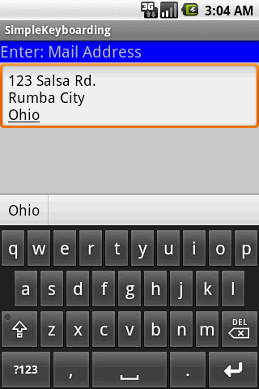
Hard And Soft Keyboards
Input Method Framework (IMF)
The IMF is aware of the available hardware and its current state.
Enabled EditText
Soft Keyboard

Slide 7
Hard And Soft Keyboards
Input Method Framework (IMF)
If there is no a readily available hardware keyboard, an input method editor(IME) will be made available to the user when they tap on an enabled EditText.
Enabled EditText
Soft Keyboard

Slide 8
Hard And Soft Keyboards
Telling Android What Data To Expect
TextView scan indicate by XML attribute or Java method the expected type of a text field:
XML
android:inputType=“...”
Java
editTextBox.setRawInputType(int)
This way Android knows the type of data to be placed in a text field. Knowing the type is useful in deciding what appropriated input method could be applied to help the user enter text.

Slide 9
Hard And Soft Keyboards
Android:inputTypeValues
Constant | Value | Description
none | 0x00000000 | There is no content type. The text is not editable.
text | 0x00000001 | Just plain old text.
textCapCharacters | 0x00001001 | Can be combined with textand its variations to request capitalization of all characters.
textCapWords | 0x00002001 | Can be combined with textand its variations to request capitalization of the first character of every word.
textCapSentences | 0x00004001 | Can be combined with textand its variations to request capitalization of the first character of every sentence.

Slide 10
Hard And Soft Keyboards
Android:inputTypeValues
Constant | Value | Description
textAutoCorrect | 0x00008001 | Can be combined with textand its variations to request auto-correction of text being input.
textAutoComplete | 0x00010001 | Can be combined with textand its variations to specify that this field will be doing its own auto-completion and talking with the input method appropriately.
textMultiLine | 0x00020001 | Can be combined with textand its variations to allow multiple lines of text in the field. If this flag is not set, the text field will be constrained to a single line.

Slide 11
Hard And Soft Keyboards
Android:inputTypeValues
Constant | Value | Description
textImeMultiLine | 0x00040001 | Can be combined with textand its variations to indicate that though the regular text view should not be multiple lines, the IME should provide multiple lines if it can.
textUri | 0x00000011 | Text that will be used as a URI.
textEmailAddress | 0x00000021 | Text that will be used as an e-mail address.
textEmailSubject | 0x00000031 | Text that is being supplied as the subject of an e-mail.
textShortMessage | 0x00000041 | Text that is the content of a short message.
textLongMessage | 0x00000051 | Text that is the content of a long message.

Slide 12
Hard And Soft Keyboards
Android:inputTypeValues
Constant | Value | Description
textPersonName | 0x00000061 | Text that is the name of a person.
textPostalAddress | 0x00000071 | Text that is being supplied as a postal mailing address.
textPassword | 0x00000081 | Text that is a password.
textVisiblePassword | 0x00000091 | Text that is a password that should be visible.
textWebEditText | 0x000000a1 | Text that is being supplied as text in a web form.
textFilter | 0x000000b1 | Text that is filtering some other data.
textPhonetic | 0x000000c1 | Text that is for phonetic pronunciation, such as a phonetic name field in a contact entry.
number | 0x00000002 | A numeric only field.

Slide 13
Hard And Soft Keyboards
Android:inputTypeValues
Constant | Value | Description
numberSigned | 0x00001002 | Can be combined with numberand its other options to allow a signed number.
numberDecimal | 0x00002002 | Can be combined with numberand its other options to allow a decimal (fractional) number.
phone | 0x00000003 | For entering a phone number.
datetime | 0x00000004 | For entering a date and time.
date | 0x00000014 | For entering a date.
time | 0x00000024 | For entering a time.

Slide 14
Hard And Soft Keyboards
android:text="inputType: text|textCapWords“: Example
Multiple types of input methods could be combined. Use “pipe” symbol | to separate the options. In the example a soft text keyboard is used, in addition it should proper capitalize each word
<?xml version="1.0" encoding="utf-8"?>
<LinearLayout
android:id="@+id/widget31"
android:layout_width="fill_parent"
android:layout_height="fill_parent"
android:background="#ffcccccc"
android:orientation="vertical"
xmlns:android="http://schemas.android.com/apk/res/android" >
<TextView
android:id="@+id/caption”

Slide 15
Hard And Soft Keyboards
android:text="inputType: text|textCapWords“: Example
Multiple types of input methods could be combined. Use “pipe” symbol | to separate the options. In the example a soft text keyboard is used, in addition it should proper capitalize each word
android:layout_width="fill_parent"
android:layout_height="wrap_content"
android:background="#ff0000ff"
android:text="inputType: text|textCapWords"
android:textStyle="bold"
android:textSize="22sp" />
<EditText
android:id="@+id/editTextBox"
android:layout_width="fill_parent"
android:layout_height="wrap_content”

Slide 16
Hard And Soft Keyboards
android:text="inputType: text|textCapWords“: Example
Multiple types of input methods could be combined. Use “pipe” symbol | to separate the options. In the example a soft text keyboard is used, in addition it should proper capitalize each word
android:padding="10px"
android:textSize="18sp" android:inputType="text|textCapWords" />
</LinearLayout>

Slide 17
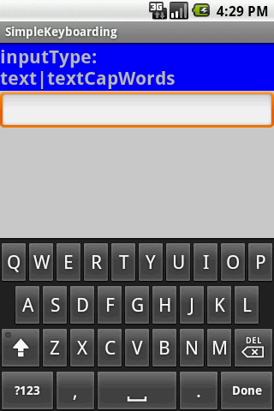
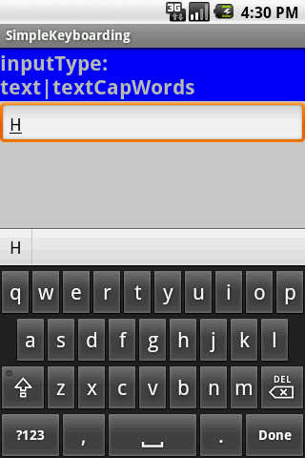
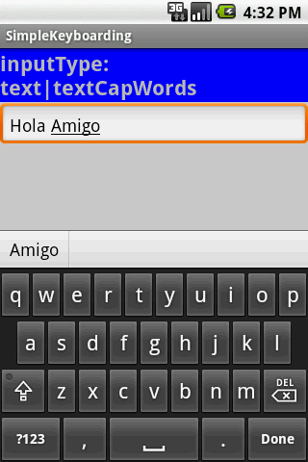
Hard And Soft Keyboards
android:text="inputType: text|textCapWords“: Example
After tapping the EditBox a soft keyboard appears showing CAPITAL letters
After first letter is typed the Keyboard switches automatically to LOWER case to complete the word.
After entering space the keyboard repeats cycle beginning with UPPER case, then LOWER case letters.

Slide 18
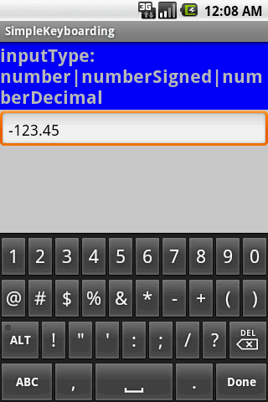
Hard And Soft Keyboards
android:inputType="number|numberSigned|numberDecimal“: Example
The keyboard displays numbers.
In general other non-numeric keys are visible but disable.
Only valid numeric expressions can be entered.
Type number|numberSigned accepts integers.
Type numberDecimal accepts real numbers.

Slide 19
Hard And Soft Keyboards
android:inputType="number|numberSigned|numberDecimal“: Example
Assume the EditText field is named: editTextBox, In Java code we could at run-time set the input method by issuing the command:
editTextBox.setRawInputType(android.text.InputType.TYPE_CLASS_PHONE) ;

Slide 20
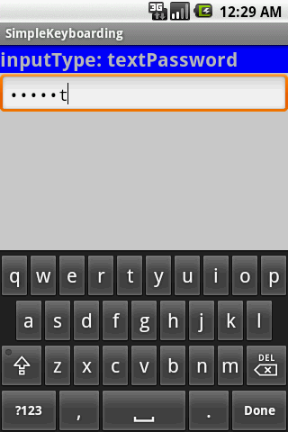
Hard And Soft Keyboards
android:inputType="textPassword“: Example
The keyboard displays all possible keys.
Current character is briefly displayed for verification purposes.
The current character is hidden and a heavy-dot is displayed.

Slide 21
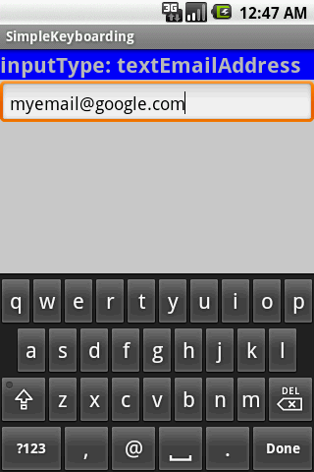
Hard And Soft Keyboards
android:inputType="textEmailAddress“: Example
Soft keyboard favors characters commonly used in email addresses such as letters, @

Slide 22
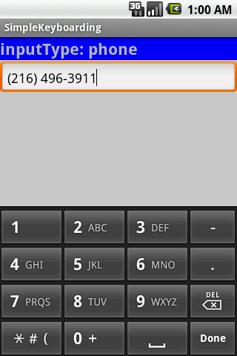
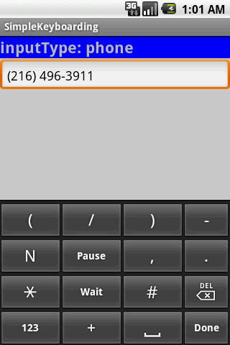
Hard And Soft Keyboards
android:inputType="phone": Example
Soft keyboard displays the layout of a typical phone keypadplus additional non digit symbols such as: ( ) . / Pause Wait # -+

Slide 23
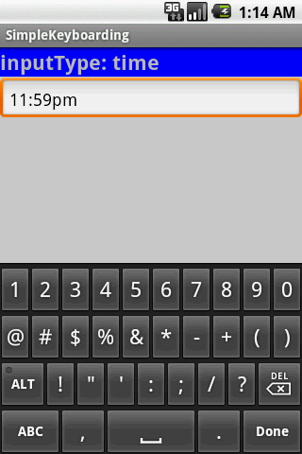
Hard And Soft Keyboards
android:inputType=“time": Example
Soft keyboard displays a numerical layout.
Only digits and colon-char ‘:’ can be used.
When clicking on alphabetic choice ABC only character to make ‘am’ and ‘pm’ are allowed.

Slide 24

Hard And Soft Keyboards
android:inputType=“time": Example
Soft keyboard displays a numerical layout.
Only digits and date valid characters are allowed.
valid dates are:
12/31/2011
12-31-2011
12.31.2011

Slide 25
Hard And Soft Keyboards
Disable Soft Keyboarding on An EditTextView
Assume txtBox1 is an EditTextbox. To disable the action of the soft keyboard on an EditText you should set its input type to null, as indicated below:
txtBox.setInputType(InputType.TYPE_NULL);
You may also try (deaf touch listener)
txtBox.setOnTouchListener(newOnTouchListener() {
@Override
publicbooleanonTouch(View arg0, MotionEventarg1) {
// return true to consume the touch event without
// allowing virtual keyboard to be called
Returntrue;}});

Slide 26
Hard And Soft Keyboards
Close SoftKeyboard Window
Close the virtual keyboard by tapping the hardware BackArrow key or issuing the following commands:
InputMethodManagerimm=
InputMethodManager) getSystemService(Context.INPUT_METHOD_SERVICE);
imm.hideSoftInputFromWindow(theEditTextField.getWindowToken(),0);

Slide 27
Hard And Soft Keyboards
TextWatcher Control
Assume txtBox1 is an Editable box. A listener of the type onKeyListener could be used to follow the actions made by the hardware keyboard; however it will not properly work with the Virtual Keyboard.
A solution to this problem is to attach to the Editable control a TextWatcher and let its methods be called when the Editable text is changed. The main methods of a TextWatcher are:
public void afterTextChanged(Editable theWatchedText)
public void beforeTextChanged( … )
public void onTextChanged( … )

Slide 28
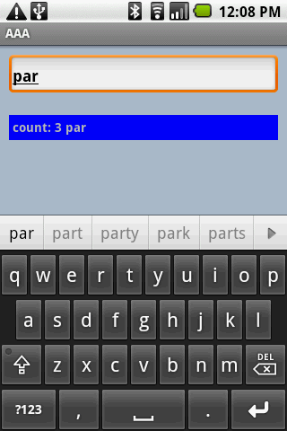
Hard And Soft Keyboards
TextWatcher Demo
EditTextuses .addTextChangedListener
IMF Suggestions

Slide 29
Hard And Soft Keyboards
TextWatcher Demo
<?xml version="1.0" encoding="utf-8"?>
<LinearLayoutxmlns:android="http://schemas.android.com/apk/res/android"
android:orientation="vertical"
android:layout_width="fill_parent"
android:layout_height="fill_parent"
android:background="#ffaabbcc"
>
<EditText
android:id="@+id/txtInput"
android:layout_width="fill_parent"
android:layout_height="wrap_content"
android:layout_margin="10px"
android:padding="4px"
android:textStyle="bold”

Slide 30
Hard And Soft Keyboards
TextWatcher Demo
/>
<TextView
android:id="@+id/txtMsg"
android:layout_width="fill_parent"
android:layout_height="wrap_content"
android:layout_margin="10px"
android:padding="4px"
android:background="#ff0000ff"
android:textStyle="bold"
/>
</LinearLayout>
// demonstrate the use of a simple TEXTWATCHER control
package cis493.keyboarding;
…

Slide 31
Hard And Soft Keyboards
TextWatcher Demo
public class TextWatcherDemoextends Activity {
EditTexttxtInput;
TextViewtxtMsg;
intkeyCount= 0;
@Override
public void onCreate(Bundle savedInstanceState) {
super.onCreate(savedInstanceState);
setContentView(R.layout.main);
txtMsg= (TextView)findViewById(R.id.txtMsg);
txtInput= (EditText)findViewById(R.id.txtInput);
txtInput.addTextChangedListener(new TextWatcher() {
public void afterTextChanged(Editable theWatchedText) {
String msg= "count: " + txtInput.getText().toString().length() + " " + theWatchedText.toString();

Slide 32
Hard And Soft Keyboards
TextWatcher Demo
txtMsg.setText( msg);
}
public void beforeTextChanged(CharSequencearg0, intarg1, intarg2, intarg3) {
//Toast.makeText(getApplicationContext(), "BTC " + arg0, 1).show();
}
public void onTextChanged(CharSequencearg0, intarg1, intarg2, intarg3) {
//Toast.makeText(getApplicationContext(), "OTC " + arg0, 1).show();
}
}); //addTextChangedListener
} //onCreate
}

